Slide 1

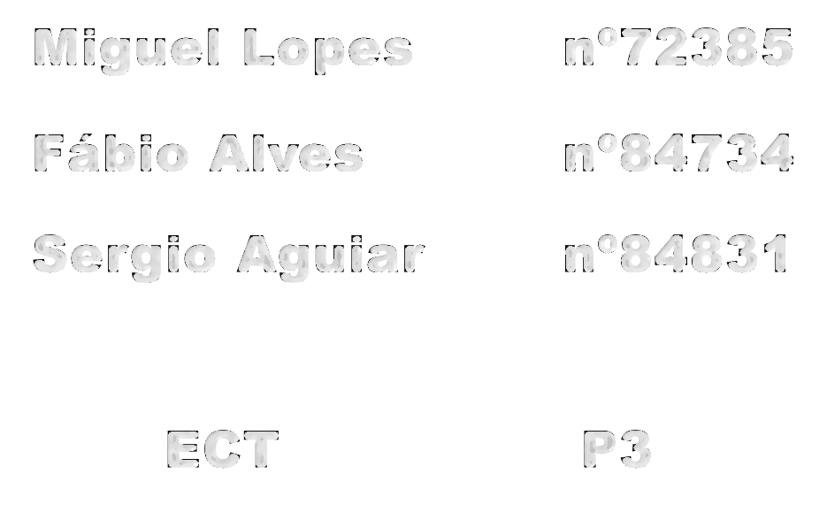
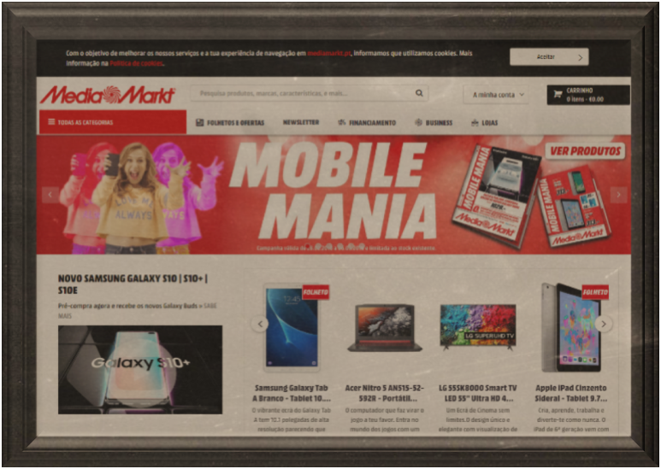
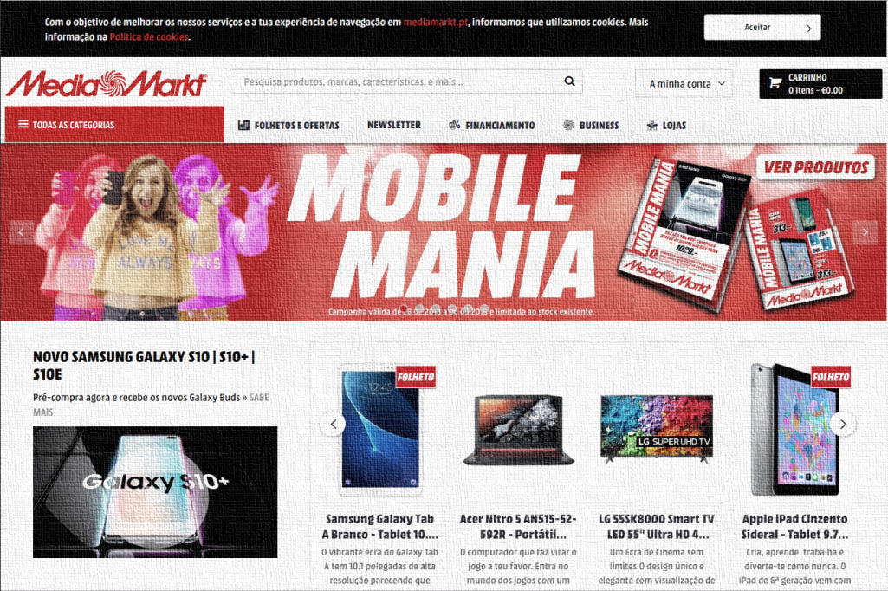
Miguel Lopes nº72385
Fábio Alves nº4734
Sergio Aguiar nº84831
ECT P3

Slide 2
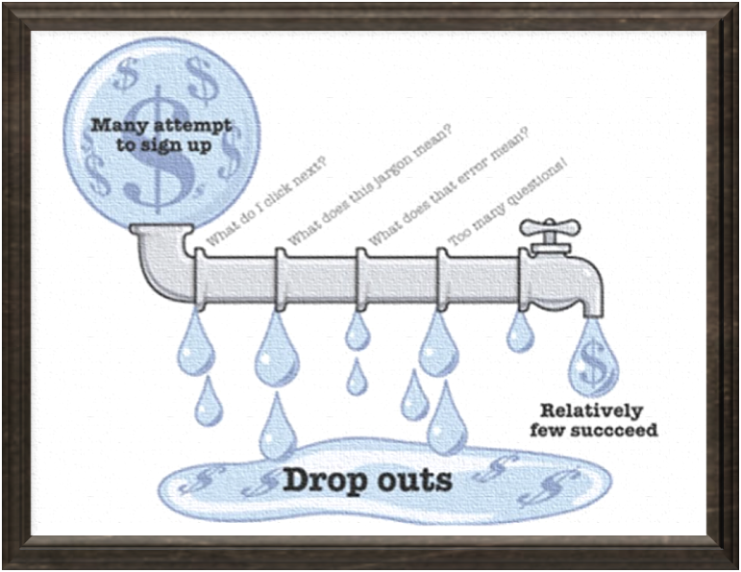
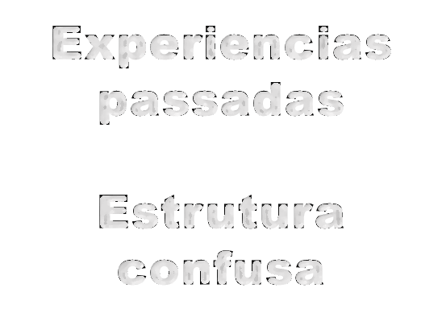
Escolha

Slide 3

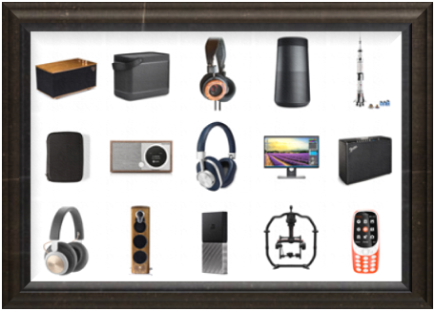




Descrição Produto
Briefly decribe the product, its objectives, target users and main UI aspects
Todos consumidores
Vendas online
Produtos eletrónicos

Slide 4




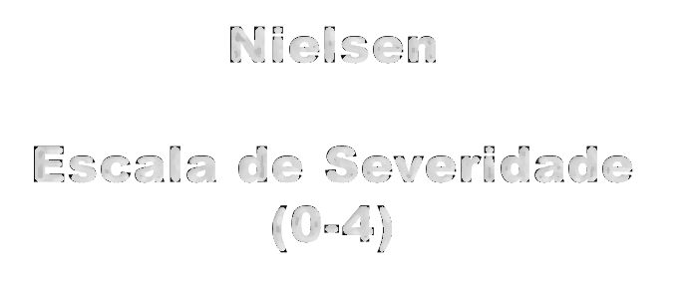
Nielsen
Escala de Severidade (0-4)
Método de Avaliação
Cognitive Walkthrough
Avaliação
Heurística
Briefly describe how the evaluation method was used (Heuristic Evaluation (HE) with which set of heuristics and severity scale, and Streamlined Cognitive Walkthrough (if used))

Slide 5


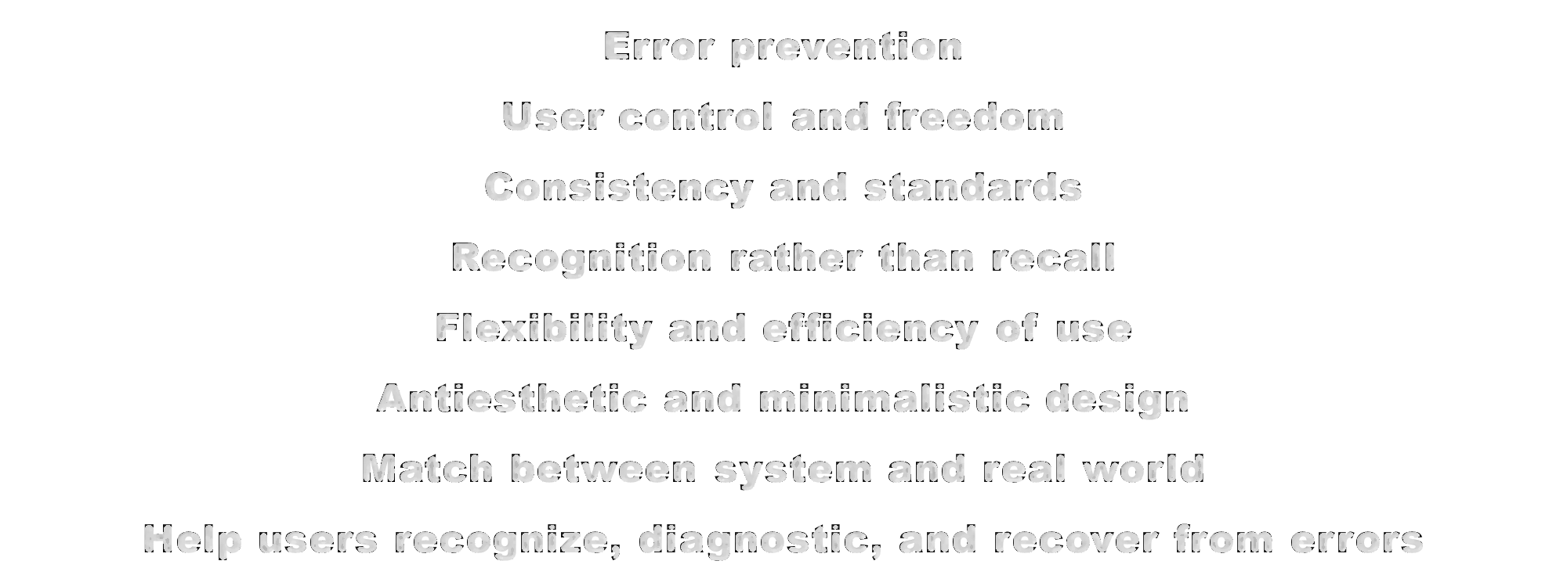
Avaliação Heurística
Error prevention
User control and freedom
Consistency and standards
Recognition rather than recall
Flexibility and efficiency of use
Antiesthetic and minimalistic design
Match between system and real world
Help users recognize, diagnostic, and recover from errors

Slide 6



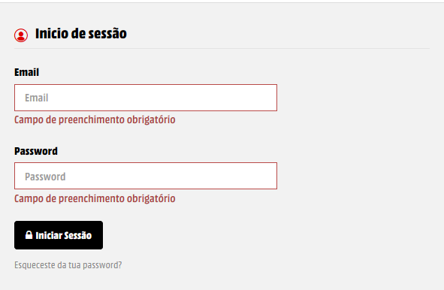
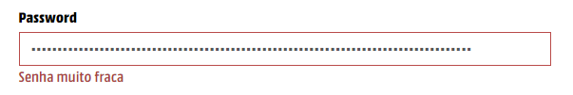
Error prevention
1

Slide 7


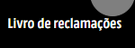

User control and freedom
3

Slide 8


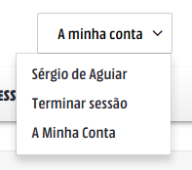


Consistency and standards
4

Slide 9

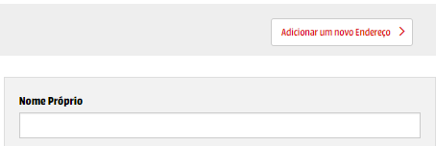
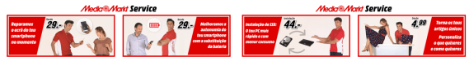
Consistency and standards

Slide 10
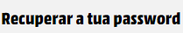
Consistency and standards

Slide 11


Recognition rather than recall

Slide 12

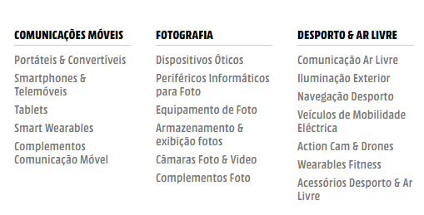
Flexibility and efficiency of use

Slide 13

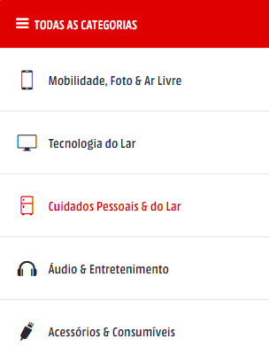

Antiesthetic and minimalistic design

Slide 14
Antiesthetic and minimalistic design

Slide 15

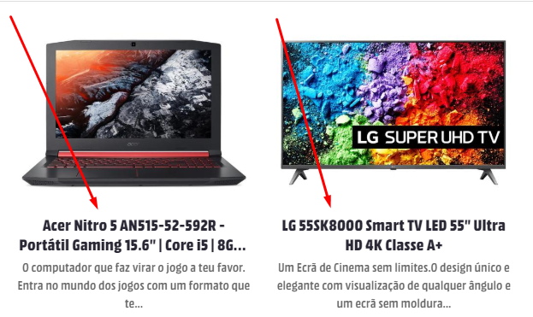
Match between system and real world

Slide 16

Help users recognize, diagnose, and recover from errors

Slide 17

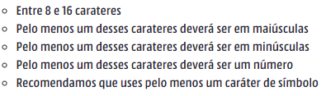
Help and documentation

Slide 18

Cognitive Walkthrough
Task: Find a RAM Memory
User: Any user of the website
Describe the main potential usability issues found with Cognitive Walkthrough
First action: Find the search bar
Steps: - Search for Memory RAM
- Filter the Search

Slide 19
Cognitive Walkthrough
Q1 - Will the user know what to do at this step?
Probably yes, since the bar is quite noticeable.

Slide 20
Cognitive Walkthrough
Q2 - If the user does the right thing (types memory ram and search), will they know that they did the right thing, and are making progress towards their goal?
Probably not, because the displayed page will be very confusing and without any type of memory ram in sight.

Slide 21
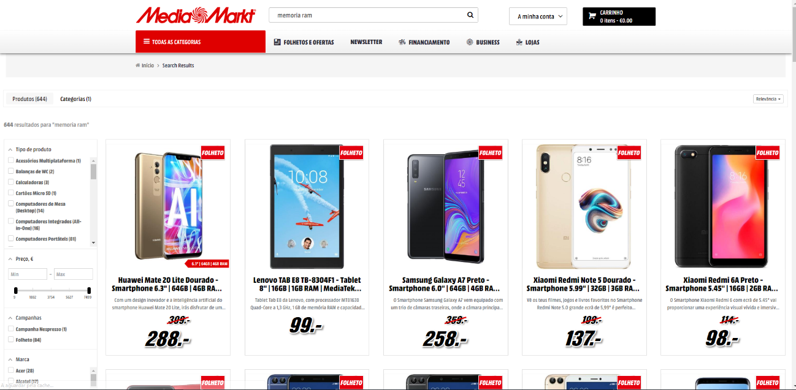
Cognitive Walkthrough
Second action: Filter the search
Describe the main potential usability issues found with Cognitive Walkthrough

Slide 22
Cognitive Walkthrough
Q1 - Will the user know what to do at this step?
Probably not since the result shown makes the user think that there is no memory ram available in the store.

Slide 23
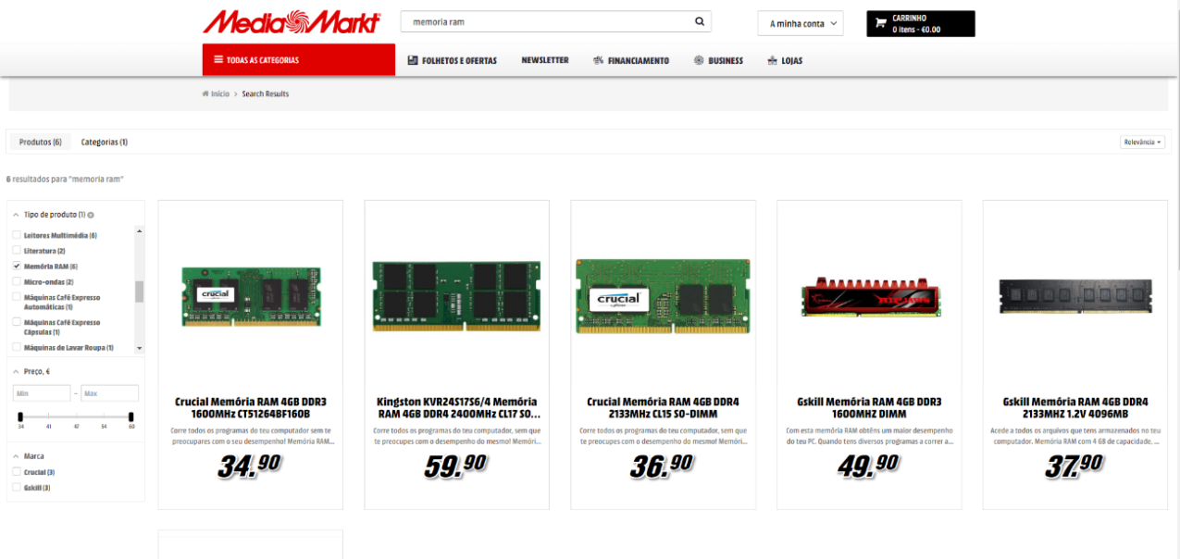
Cognitive Walkthrough
Q2 - If the user does the right thing (filter for memory ram), will they know that they did the right thing, and are making progress towards their goal?
Probably yes, because after filtering the result, the results displayed will be only products that the user wants.

Slide 24
Cognitive Walkthrough
Describe the main potential usability issues found with Cognitive Walkthrough
Task: Change Password
User: Any user of the website
First action: Logout of your account
Steps: - Logout of your account
- Go to login page
- Go to forgot password

Slide 25
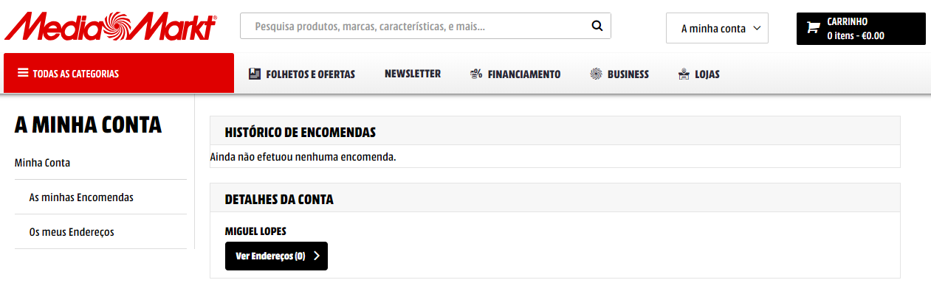
Cognitive Walkthrough
Q1 - Will the user know what to do at this step?
Probably not, because normally when you want to change information associated to your account in any website you do it when you are logged into the account.

Slide 26
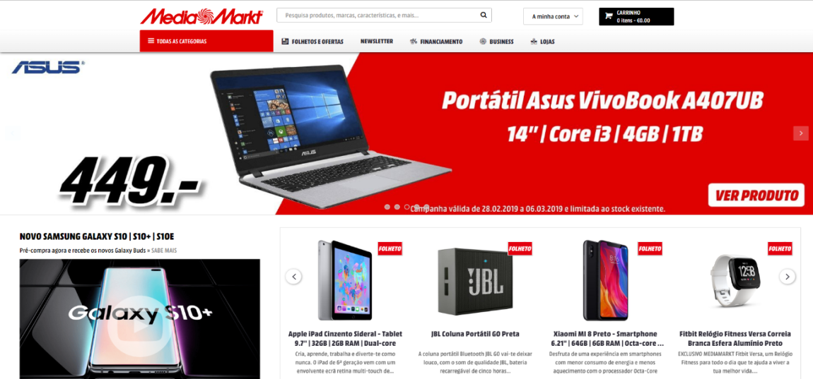
Cognitive Walkthrough
Q2 - If the user does the right thing (logout of the account), will they know that they did the right thing, and are making progress towards their goal?
Probably not, because the website sends you to the main page instead of the log in screen where you can find the “forgot your password?” button.

Slide 27
Cognitive Walkthrough
Second action: Go to login page
Describe the main potential usability issues found with Cognitive Walkthrough

Slide 28
Cognitive Walkthrough
Q1 - Will the user know what to do at this step?
Probably yes, because the button saying “Your account” is quite visible.

Slide 29
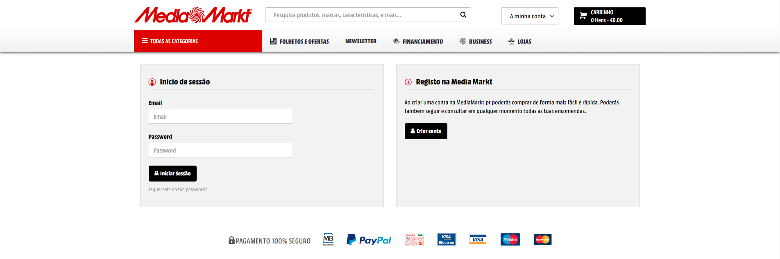
Cognitive Walkthrough
Q2 - If the user does the right thing (go to login page), will they know that they did the right thing, and are making progress towards their goal?
Probably not, because once again its not normal to change the password outside of your user details inside your account information.

Slide 30
Cognitive Walkthrough
Third action: Forgot your password?
Describe the main potential usability issues found with Cognitive Walkthrough

Slide 31
Cognitive Walkthrough
Q1 - Will the user know what to do at this step?
Probably not, again for the same reason of being an uncommon method to change the password.

Slide 32
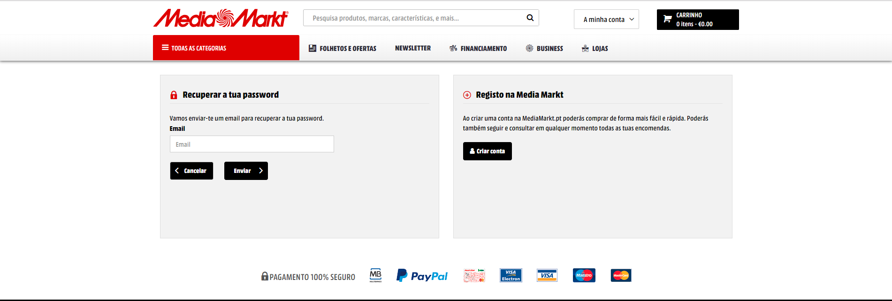
Cognitive Walkthrough
Q2 - If the user does the right thing (go to login page), will they know that they did the right thing, and are making progress towards their goal?
Probably yes, because you have a box to input your email and send to restore your password.

Slide 33
Cognitive Walkthrough
Describe the main potential usability issues found with Cognitive Walkthrough
Task: Change account email
User: Any user of the website
First action: Go to help
Steps: - Find that you need to contact support

Slide 34
Cognitive Walkthrough
Q1 - Will the user know what to do at this step?
Probably not, because the user will look into his account information for buttons to try to change the e-mail.

Slide 35
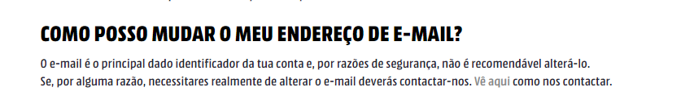
Cognitive Walkthrough
Q2 - If the user does the right thing (go to help), will they know that they did the right thing, and are making progress towards their goal?
Probably yes, because if the user goes to the help page in order to look for help to change the e-mail, he will eventually stumble upon that information.

Slide 36
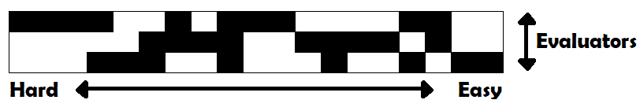
Tabela de Avaliação Heurística

Slide 37
Apreciação final do produto
O website em questão é confuso e redundante. Permite os utilizadores realizarem as operações necessárias, contudo poderá levar a situações indesejadas a um bom ritmo.

